Slide 1
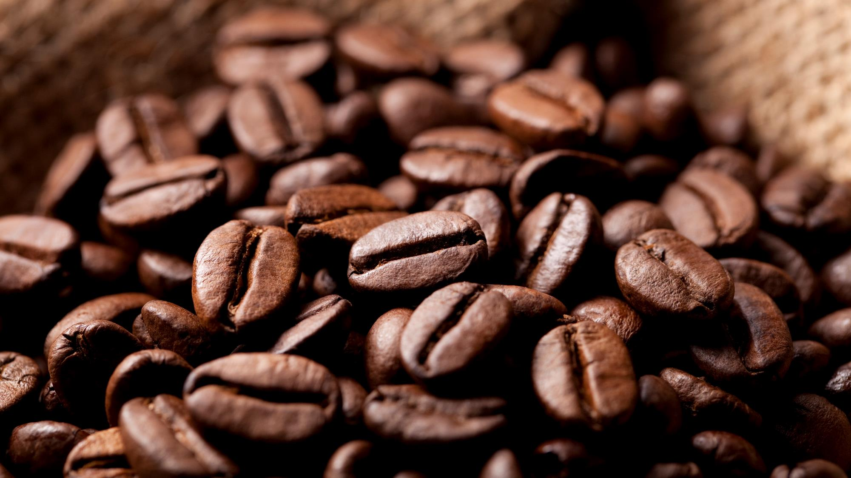

Lucky Cafe
The Krisztián nonprofit kft property

Slide 2
Client requirement
<-client
-Main page
-Coffe webpage(daily offer)
-Cookies webpage(daily offer)
-Blog
-Article

Slide 3

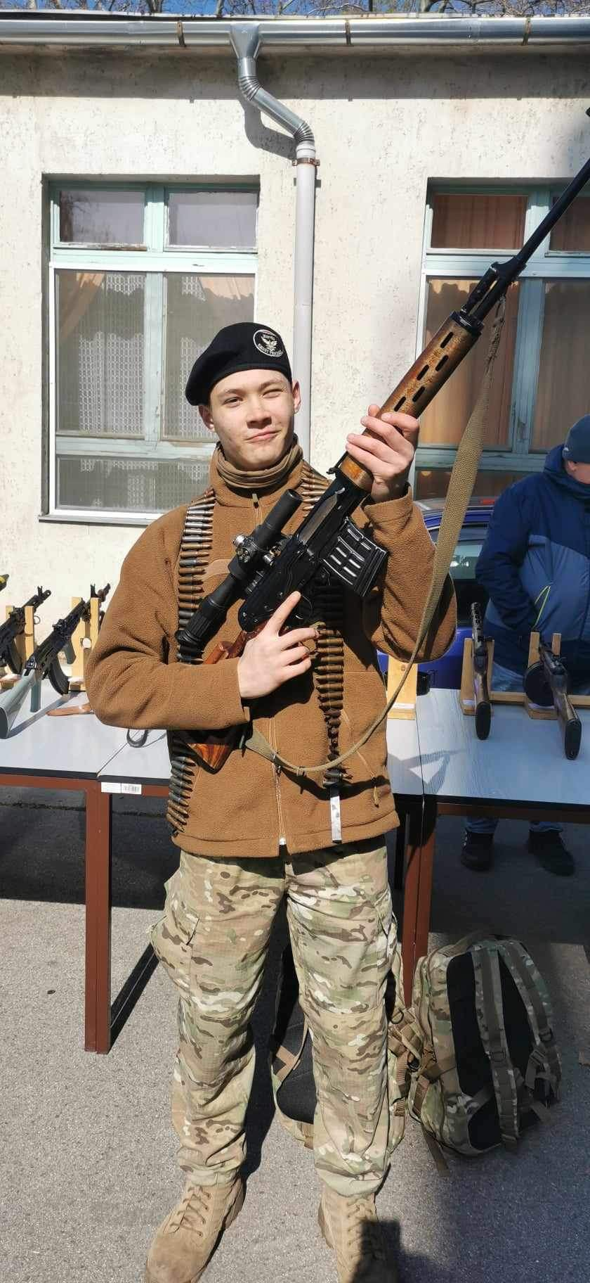
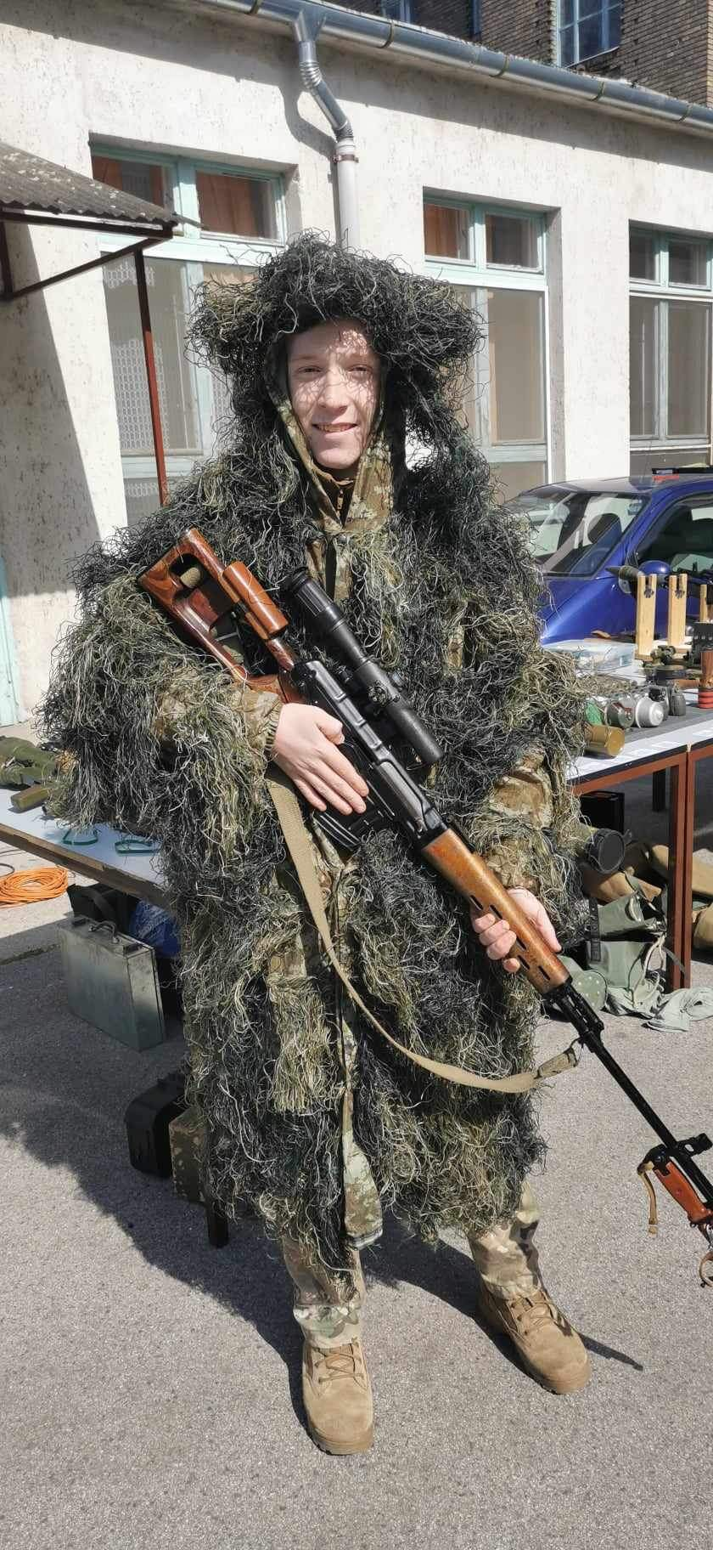
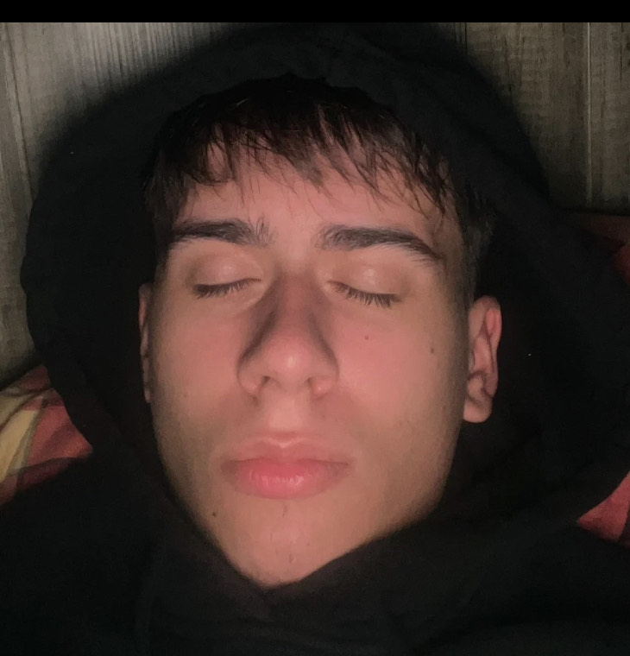
Team
Coding of the main page
Coding of cookies webpage
Coding of coffe webpage
Coding of the blog
Krisztián
Zsolt
Milán
Tibi

Slide 4
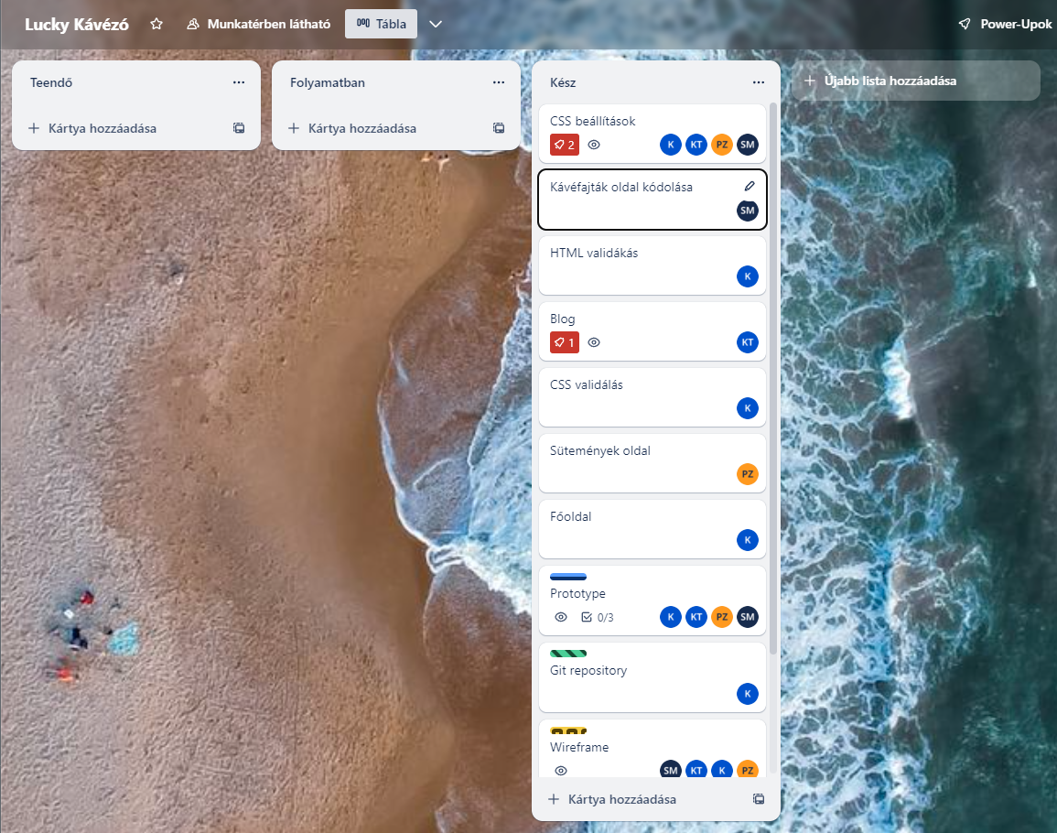
Projekt planning
CSS – everyone
Coffe page – Milán
HTML and CSS validation – Krisztián Blog page – Tibi
Cookies page – Zsolt Main page – Krisztián Git repository – Krisztián Prototype - everyone

Slide 5
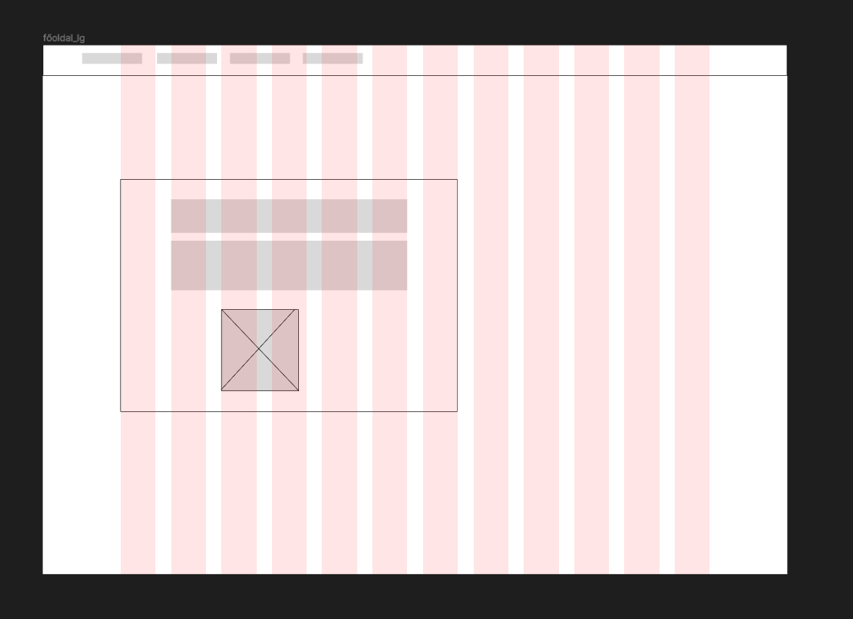
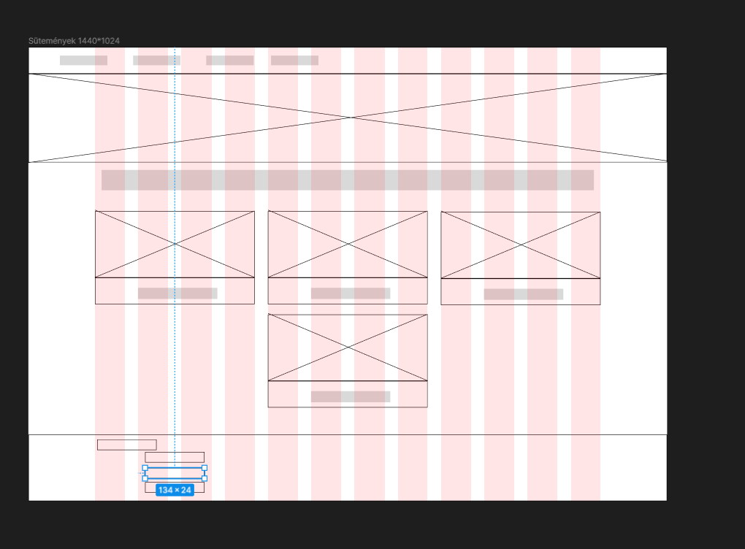
Wireframe

Slide 6
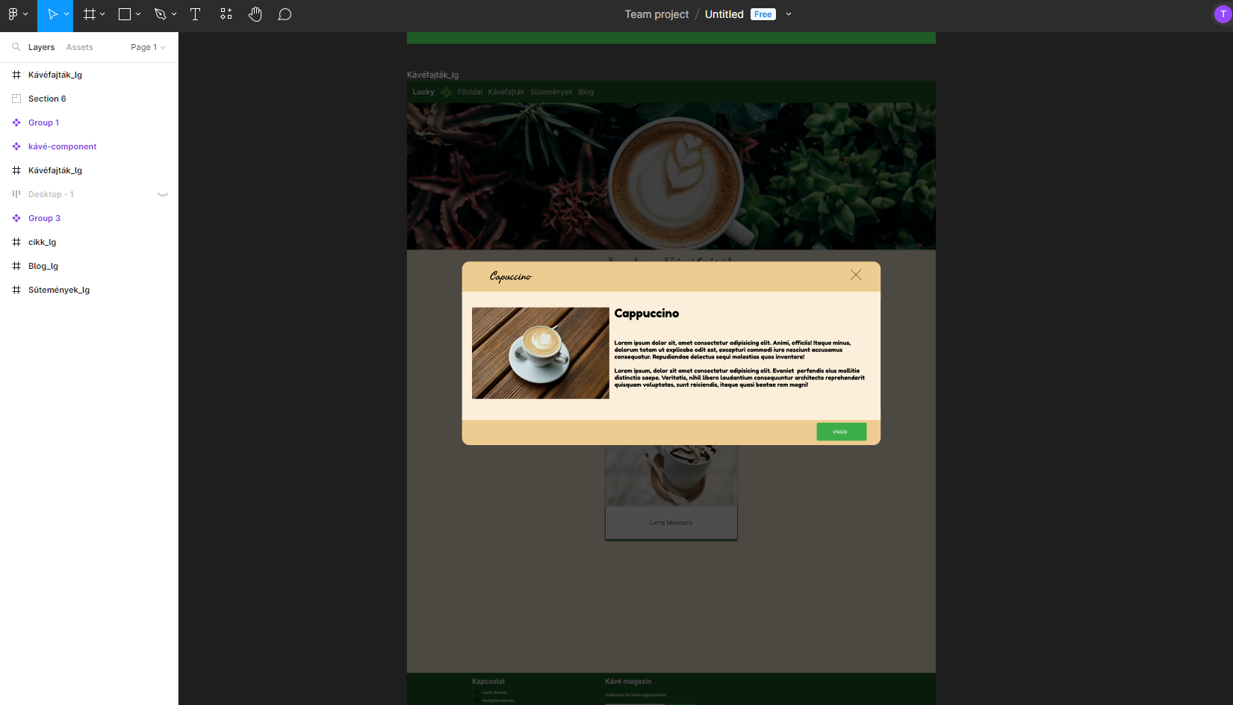
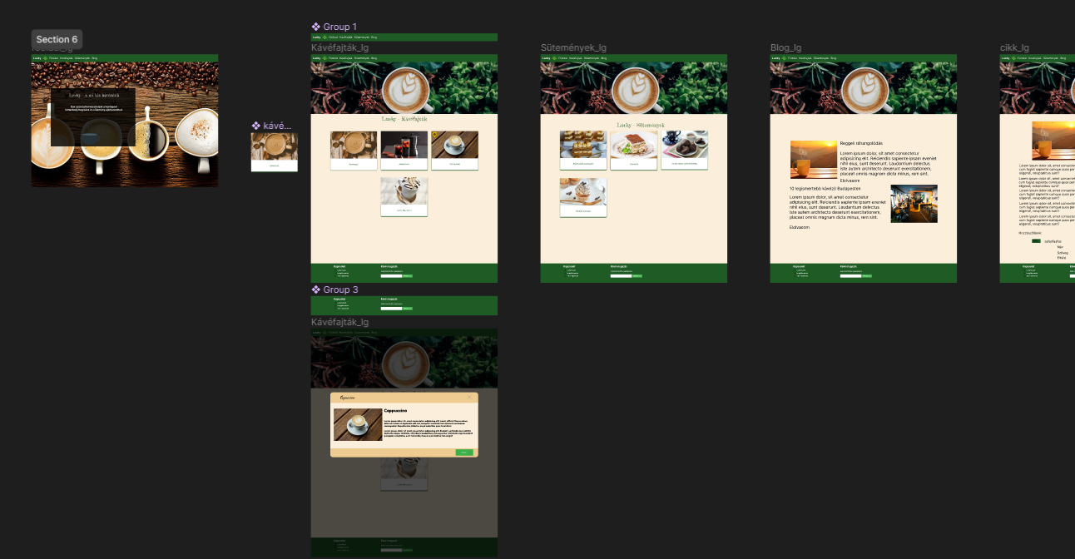
Prototype

Slide 7
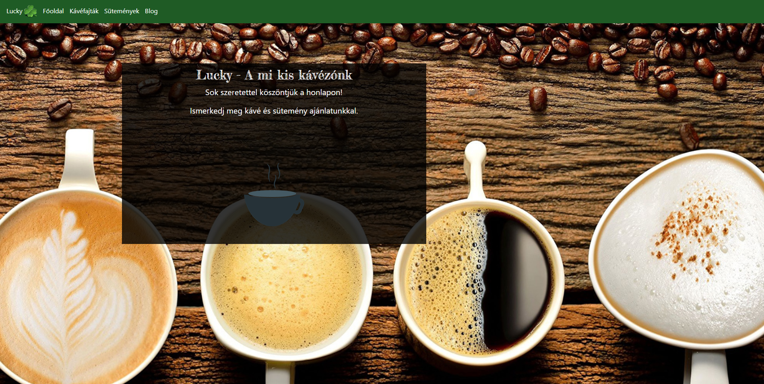
Main page

Slide 8
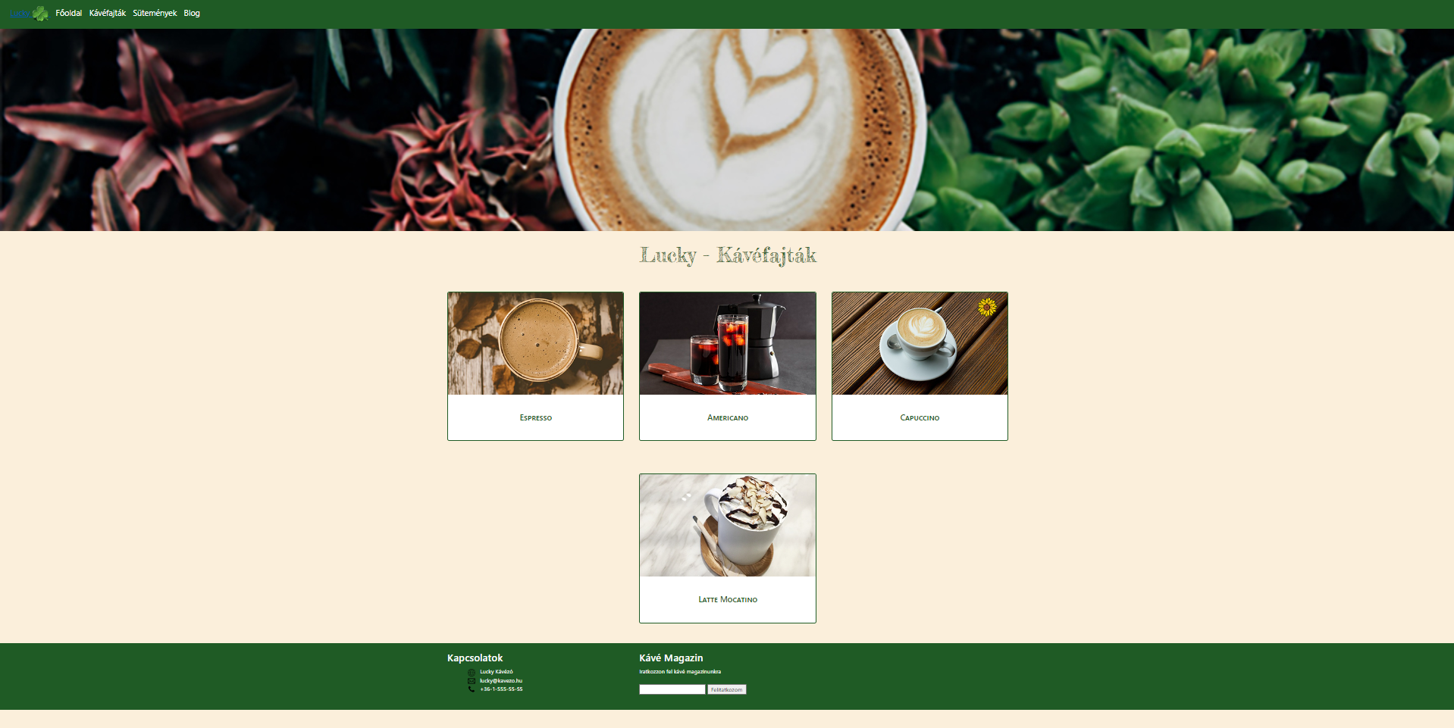
Coffe webpage

Slide 9
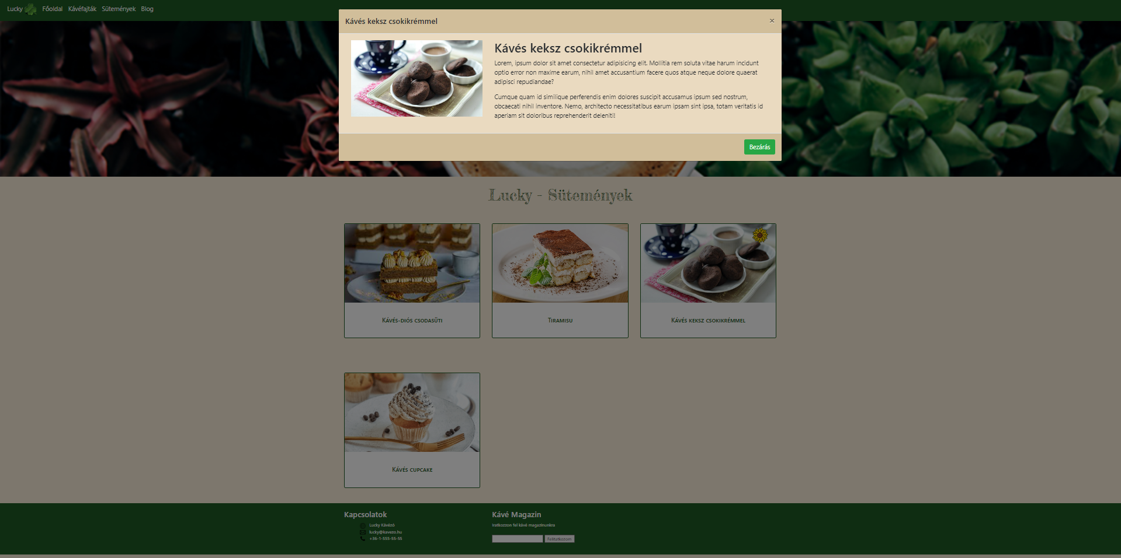
interactive interface

Slide 10
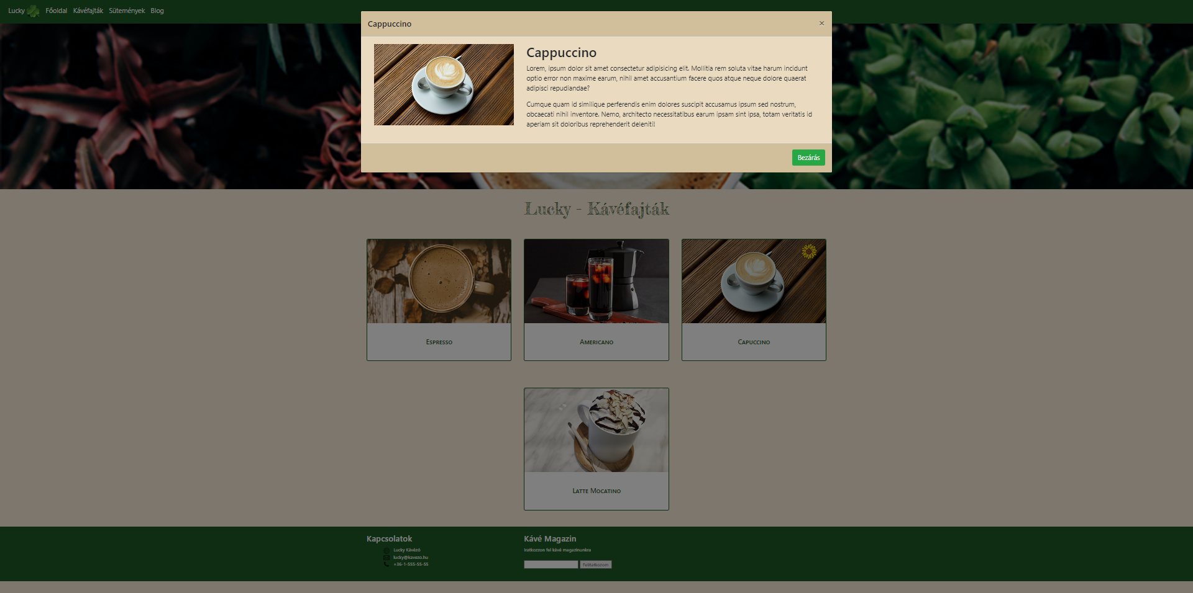

Slide 11
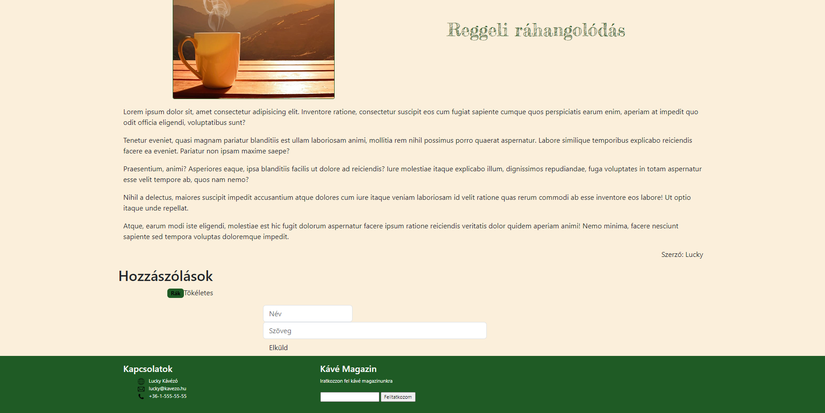
Blog webpage

Slide 12
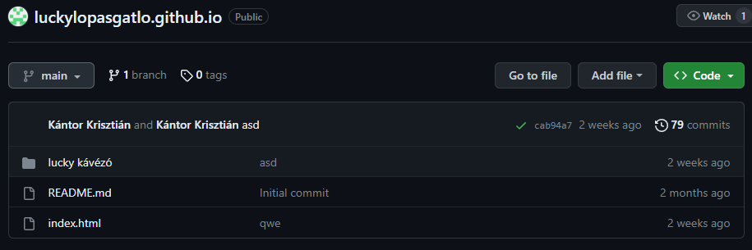
Github

Slide 13
Webpages link
https://tsikkk.github.io/luckylopasgatlo.github.io/

